Slide 1
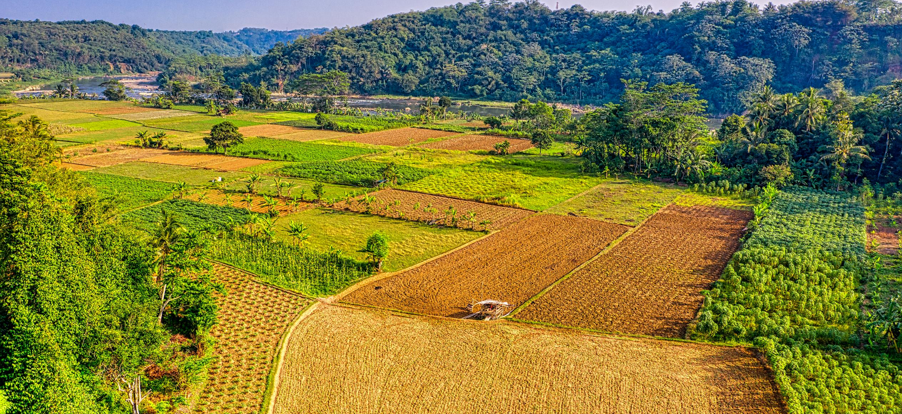
Face Detection
Supervised by:
Prof. Dr.-Ing. Dieter Maier

Slide 2
Goals
  Illumination, and shadows
  Occlusion: if the face is covered.
  Distance from camera, resolution of camera and angle of camera.
  Skin color and skin tones or racial appearance
  Detect what will happen with movements of the person.
    Excel gantt chart:
Introduction Previous Work Methodology Results Future Work Conclusion

Slide 3
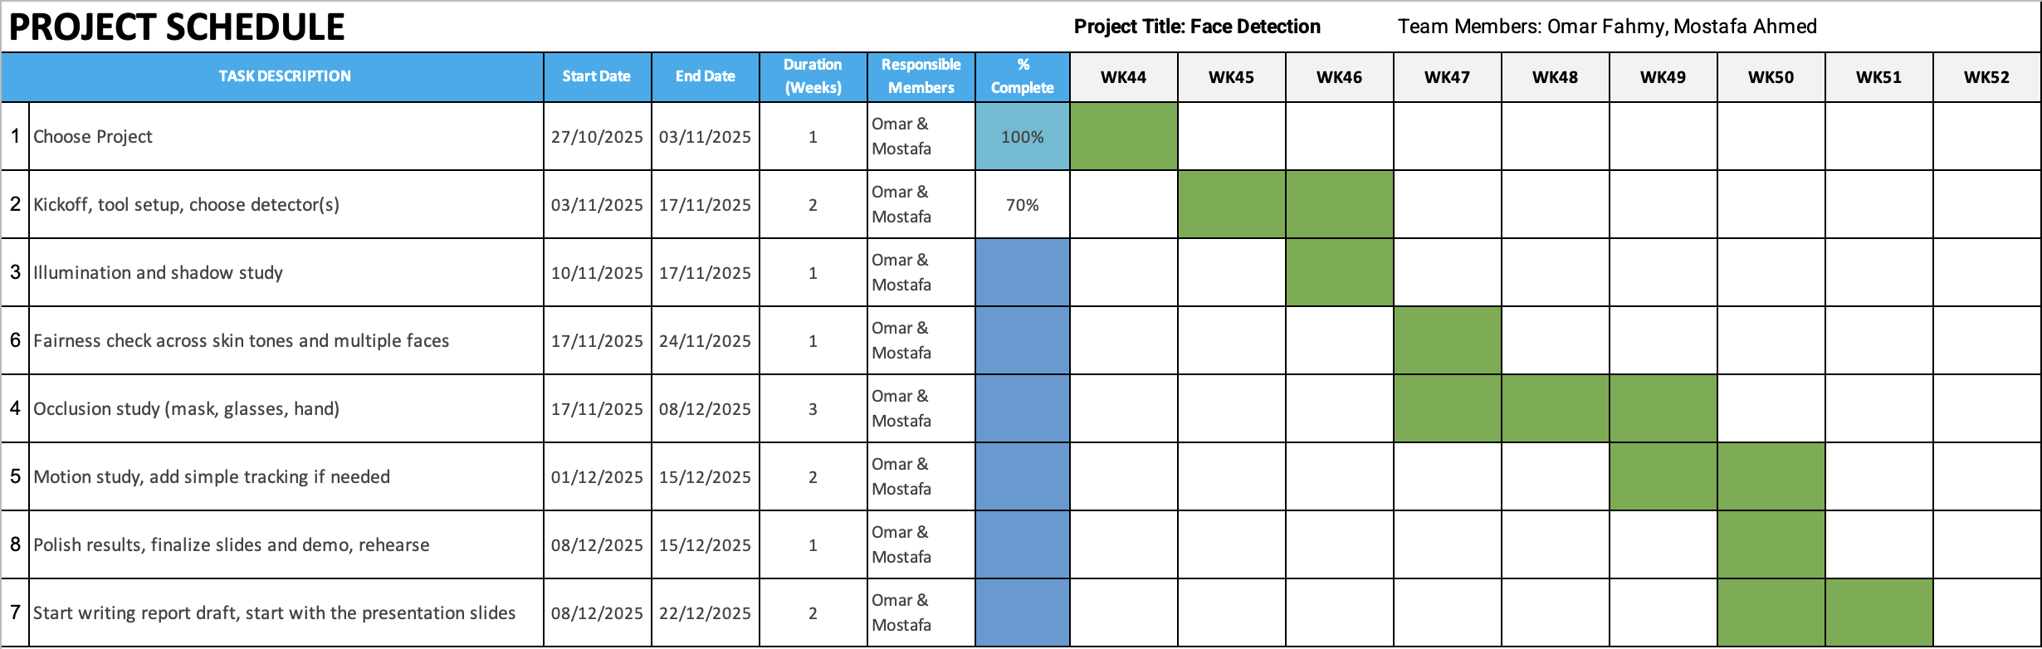
Excel gantt chart
Introduction Previous Work Methodology Results Future Work Conclusion

Slide 4
problems
  cap = cv2.VideoCapture(0, cv2.CAP_AVFOUNDATION)
  Video runs faster than actual (different fps)
Introduction Previous Work Methodology Results Future Work Conclusion

Slide 5
problems
  cap = cv2.VideoCapture(0, cv2.CAP_AVFOUNDATION)
  Video runs faster than actual (different fps)
Introduction Previous Work Methodology Results Future Work Conclusion

Slide 6
Problems with haar
Not Detecting when:
  Part of the face is out of frame
  Face is not facing the camera
  Face is tilted
  Face is partially blocked by object (works when partially blocked by hand)
Other problems:
  Sometimes detecting other objects as faces
Introduction Previous Work Methodology Results Future Work Conclusion

Slide 7
Problems with dnn
Not Detecting when:
  Face is tilted
Other problems:
  Sometimes detecting other objects as faces
Introduction Previous Work Methodology Results Future Work Conclusion

Slide 8
Options we have
  Use Haar and add preprocessing
  Use DNN and add preprocessing
  Use both together, then add preprocessing??
Introduction Previous Work Methodology Results Future Work Conclusion

Slide 9
Thank you!

Slide 10
Any questions?

